Slide 1
To-Do List Application
Team Information:
Jaya Chandu Mandava - 700733924
Venkata Lakshmi Sasank Tipparaju - 700738838

Slide 2
Agenda
Features
Technologies Used
Database Structure
Sample Screenshots

Slide 3
Application Features:
User Registration and Login
All To-do’s dashboard
To-do’s / tasks Prioritization
To-do’s/tasks are Organized with due_date in dashboard
CRUD operations (Task create, read, update and delete)
Can mark complete once done
Can categorize into personal or work related

Slide 4
Technologies Used:
Frontend: PHP, CSS, Javascript, jQuery, Boostrap
Backend: PHP
Database: MySQL

Slide 5
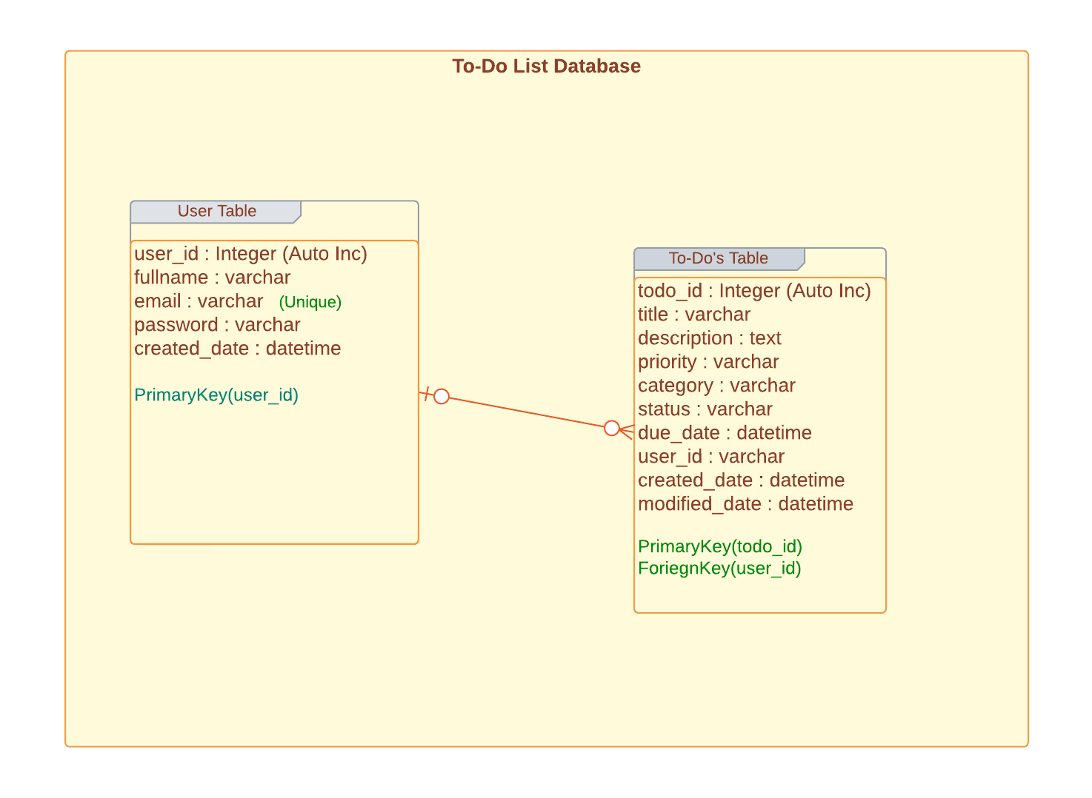
Database diagram

Slide 6
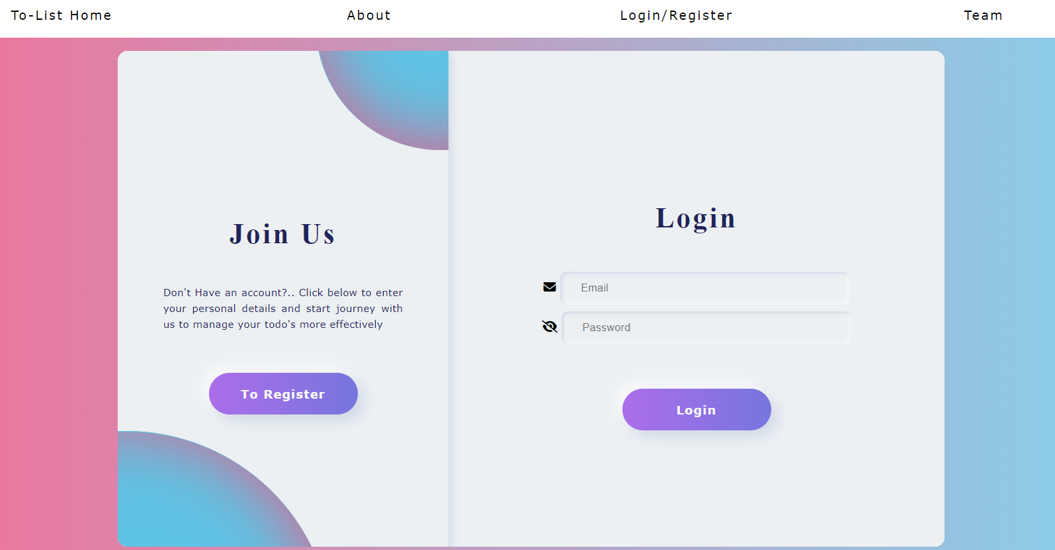
Login/Registration – Sample Screenshot

Slide 7
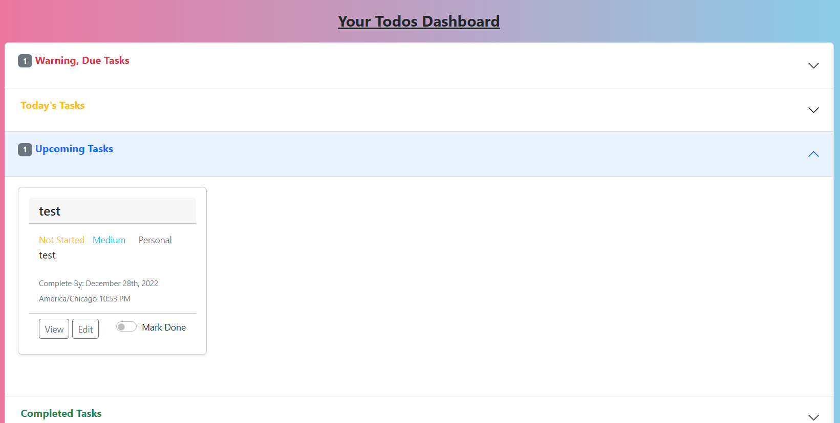
Dashboard - SS

Slide 8
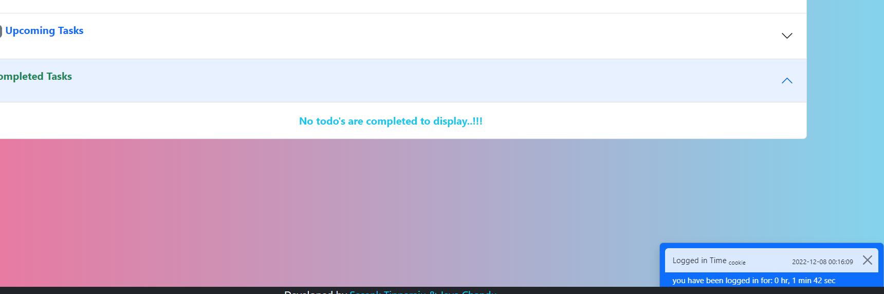
Usage of Cookie, to display login duration -SS

Slide 9
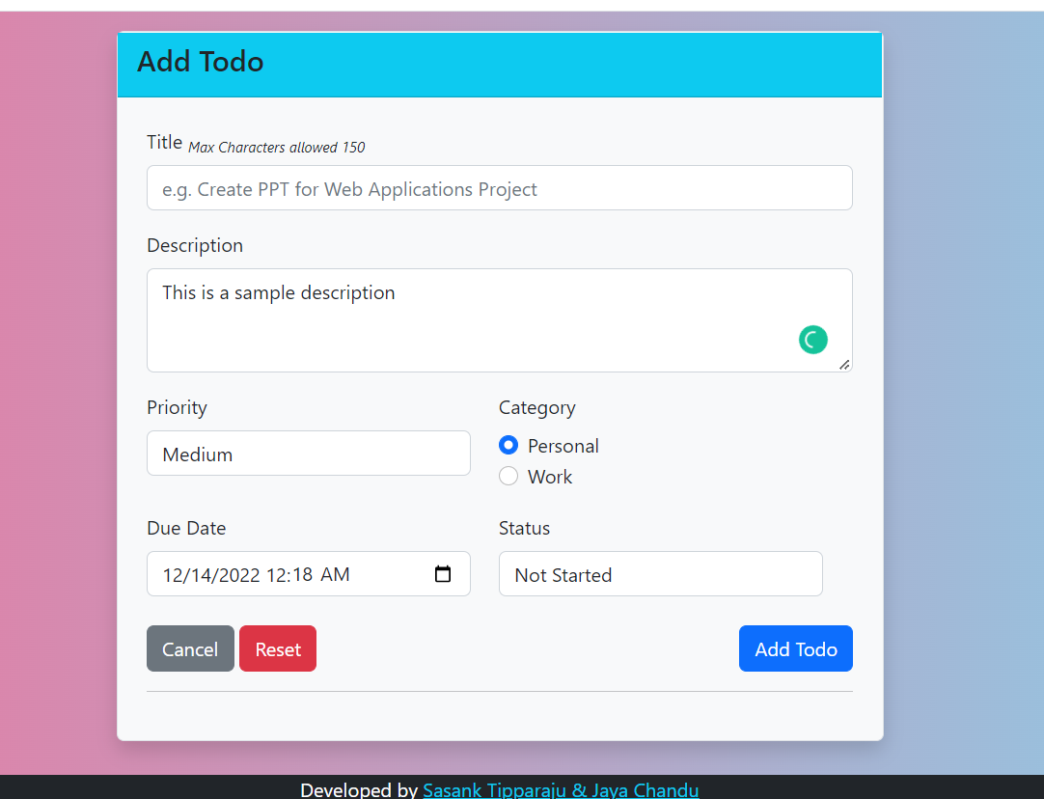
Add Task- SS

Slide 10
Thank you

